Slide 1
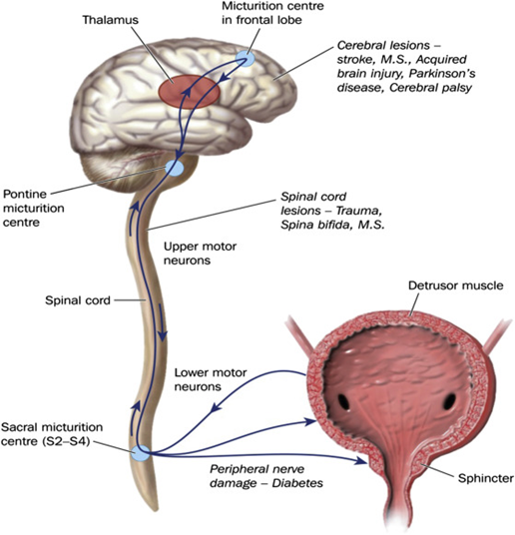
Urinary tract dysfunction
in
Multiple Sclerosis
Mahnaz Talebi
Professor of Neurology
Tabriz university of medical sciences

Slide 2
Multiple Sclerosis
Immune mediated disease of the CNS
affects an estimated 2,800,000 people in the world
leading cause of non-traumatic neurological disability in young adult
mean age of onset, 20-30 years
F:M,3:1
can lead to physical disability, cognitive impairment, and decreased quality of life
reduces life expectancy by 7 to 14 years

Slide 3
Multiple Sclerosis
inflammation with demyelination
Astroglial proliferation (gliosis) and neurodegeneration

Slide 4
Environmental and
Genetic Risk Factors
Smoking
Obesity
Low sun exposure
Around 20% of the heritability risk is attributable to common genetic variants
HLA DRB15:01 haplotype (odds ratio (OR) of ~3)

Slide 5
Natural History of MS Pre-treatment Era

Slide 6
MS natural course with treatment

Slide 7
MS Criteria over the years

Slide 9
T2 weighted images abnormalities in MS
Notes:
Multiple hyperintense lesions on T2- weighted sequences are the characteristic MR appearance of multiple sclerosis. The majority are small although, lesions can occasionally measure several centimeters in diameter.

Slide 10
Prodromal MS

Slide 11
Signs and symptoms

Slide 12
Neurogenic bladder dysfunction
Neurogenic bladder dysfunction is common in patients with MS and is associated with pontine and spinal cord lesions.
Urinary symptoms are broadly categorized into:
failure to store (urinary frequency)
failure to empty (urinary retention),
or a combination of both.

Slide 13
In contrast to other neurologic disorders affecting the spinal
cord, such as spina bifida, upper urinary tract disorders in MS are rare, possibly because of the slowly progressive nature of the disease.

Slide 14
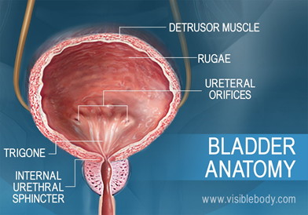
Urinary tract dysfunction in MS
Urinary tract dysfunction is quite common during the course of
multiple sclerosis (MS), not only representing a considerable
psychosocial burden, but also often requiring care, hospitalization and
posing a great challenge for the treatment team.

Slide 15
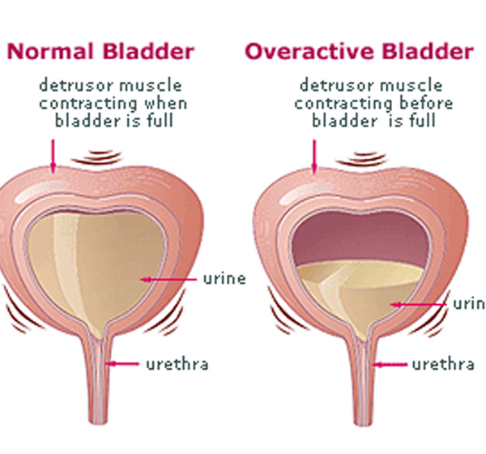
Detrusor and sphincter disorders in multiple sclerosis
Detrusor and sphincter disorders are all but inevitable in the evolution of MS. The fluctuations in their prevalence (reports range from 32% to 96.8%) reflect difference in time of examination
Appearing on average 6 years after the onset of the disease detrusor and sphincter disorders may affect one patient out of 10 at the time of initial clinical manifestation of MS

Slide 16
Clinical presentation and influencing factors
1- The predominance of overactive bladder syndrome characterized by urgency, urinary frequency and/or urge incontinence (irritative symptoms), is constantly reported with a prevalence of 37- 99% of
patients

Slide 17
2- Obstructive symptoms are also frequently reported, affecting between 34% and 79% of patients and in 25% of cases resulting in chronic urinary retention .
3- Irritative and obstructive symptoms often coexist, and may jointly affect up to 59% of men and 51% of women
The clinical presentation of vesicourethral dysfunction (VUD) is variable over time.

Slide 18
The appearance of new symptoms, mainly of the irritative type, may affect up to one third of patients over a period of 42 months .
Overall, the clinical presentation of VUD offers little information on the type and severity of the detrusor-sphincter disorders
There is little correlation between the clinical and urodynamic symptomatology and while a combination of irritative symptoms and detrusor overactivity is sometimes reported ,

Slide 19
Two factors likely to influence the clinical presentation of VUD in MS have an established :
the MS duration:
the severity of the neurological deficiencies and disabilities:
The prevalence of irritative symptoms is also correlated with the severity of pyramidal damage (EDSS), but , the correlation between urinary retention and neurological status is still controversial

Slide 20
a link between MRI data and clinical symptoms of VUD has not been established
Age: has no direct influence.
gender:
women may be predisposed to urinary incontinence and the irritative symptoms
men to the obstructive symptoms

Slide 21
Urodynamic presentation and influencing factors
The poor specificity of the clinical symptoms in MS
VUD and the identification of specific cystometric

Slide 22
The most frequent cystomanometric picture
The most frequent cystomanometric picture is detrusor overactivity (65%)
detrusor underactivity (25%)
poor bladder compliance (21%).
Detrusor- sphincter dyssynergia (DSD) is diversely estimated with a prevalence of 5- 83% and a mean of 35%,

Slide 23
Urodynamic presentation
Cystometrogram can be considered normal in 1-34% of symptomatic patients
The combination of the urodynamic patterns is frequent and detrusor overactivity can be combined with DSD in 43-80% of

Slide 24
Cystometrogram may change over time independently of any
micturitional and neurological clinical stability

Slide 25
Urodynamic presentation and influencing factors
Age: There is not sufficient argument to direct influence of age on the urodynamic presentation of VUD in MS.
Gender: significant increase in the maximum amplitude of the uninhibited detrusor contractions, of the detrusor leak point pressure
(lowest detrusor pressure at which urine leakage occurs in the absence of either a detrusor contraction or increased abdominal pressure) and of the maximum detrusor pressure in men as compared to women

Slide 26
Urodynamic presentation and influencing factors
Duration of the MS : influences the urodynamic presentation of VUD only for DSD. Thus, DSD is present in 13% of patients after 48 months, and in 48% after 109 months of MS duration

Slide 27
Disease type: There is no specific urodynamic presentation linked to remittent or progressive form
MS activity :
between the MS activity (estimated by the basic
protein level in the CSF) and the presence of DSD
and/or of detrusor overactivity has been reported

Slide 28
Neurological states: Correlations between the neurological and cystomanometric states have been reported.
The correlation between detrusor overactivity and DSD and the
severity of motor deficiencies (EDSS) appear

Slide 29
existence of a correlation between certain lesional sites and the cystomanometric data : controversial ,
But the presence of encephalic or suprasacral lesions
and lesions on the brain stem may be a predisposing
factor for DSD and detrusor undercontractility respectively

Slide 30
Urinary tract complications from neurogenic bladder in MS
The literature review indicates that the overall prevalence of urinary
tract complications in MS is between 0% and 40% in series including
patients until 18 years of MS follow-up

Slide 31
Complications of lower urinary tract
Lower urinary tract infections:
Lower urinary tract infections are reported in 30% of patients

Slide 32
In clinical study about the lower urinary infection risk factor in MS:
influence of the post-void residual volume (180 mL compared to 119 mL on average)
and of the female gender (42% of urinary infection in women compared to 17% in men)

Slide 33
Bladder cancer
Three publications, including one retrospective study, suggest that
the risk of bladder cancer is greater in MS than in the general population, especially
1- in patients under chronic catheterization (indwelling catheter or suprapubic catheter) and
2- having been treated with immunosuppressants

Slide 34
In addition to two control cases of condylomas
in two MS patients treated with immunosuppressants
for 13 years .
de Ridder et al. report the occurrence of seven vesical cancers, six transitional cell carcinomas and one epidermoid
carcinoma in a population of 2351 patients assessed over a period of 31 years

Slide 35
In the series of 1271 patients with an indwelling or suprapubic catheter
In an annual cystoscopic
Six of the seven bladder cancers occurred in patients with an indwelling or
suprapubic catheter for 3.3 years and the last in a
patient having been under intermittent self-catheterization (ISC) for 4 years.
The first alarm signal was haematuria.
All seven patients had previously been treated with cyclophosphamide

Slide 36
The overall incidence of bladder cancers in that MS population
was 0.29% higher than in the general population
The risk of bladder cancers appeared higher in patients with indwelling or suprapubic catheters (an incidence of 0.7%) and
in the ISC patients (an incidence of 0.23%),
with immunosuppressants (incidence of 5.7%)

Slide 37
Complications of the upper urinary tract
Complications of the upper urinary tract are reported
in 12% of patients
These include, in order of frequency:
upper urinary tract infections: 8%
dilatations of the upper urinary tract, 8% of patients
vesicoureteral reflux, found in 5% of patients
urinary lithiasis vary from 2% to 11%

Slide 38
No increased risk of renal failure in the MS population as compared to
the general English population has been proven

Slide 39
Mortality due to urinary tract disorders
Two studies mention the rate of death related to a urological cause, one giving 55% of 20 deaths and the other 5% of 75 Deaths.
A Dutch epidemiological study assessing the factors influencing the life expectancy of 216 MS patients fails to prove any death from a urological cause, but reports a survival rate after 40 years of MS progression. This rate is significantly lower in those patients with an onset of VUD during the first 10 years of MS progression (6.4% survivors) compared to those patients where VUD occurred after 10 years (29.2% survivors)

Slide 40
Risk factors of upper urinary tract complications in MS

Slide 41
MS duration
Seventeen clinical studies provide useable data on the prevalence of upper urinary tract complications in MS
Figures illustrates an increasing prevalence of complications with passing years.

Slide 42
Risk factors of upper urinary tract complications in MS
Gender:
No direct correlation between gender and upper urinary tract complications has been found .
A greater risk of pyelonephritis has also been reported in men suffering from low urinary infections
in men the greater frequency of urodynamic criteria predisposing towards damage to the upper urinary tract (high detrusor pressure and frequent uninhibited contractions of the detrusor) may constitute an additional risk factor .

Slide 43
Risk factors of upper urinary tract complications in MS
Age:
Some studies find that the average age is higher in the population of patients with upper complications compared to the population without complications
Progression of MS:
No influence of the type of progression of MS, remittent or progressive, on the urinary tract prognosis has been proven

Slide 44
Risk factors of upper urinary tract complications in MS
Pyramidal symptoms:
A correlation between the severity of pyramidal symptoms and the prevalence of complications of the upper urinary tract has been reported
mean EDSS pyramidal scores of
4.1 and 3.1 respectively in patients with and without damage to the upper urinary tract

Slide 45
Risk factors of upper urinary tract complications in MS
Urologic clinical symptom:
The influence of the urologic clinical symptom on the urinary tract prognosis is modest .
In patients presenting a postmicturitional residue >30% of the vesical capacity, only an increased frequency of pyelonephritis has been reported
Urodynamically, correlations have been reported between the prevalence of complications of the upper urinary tract and the high amplitude of uninhibited contractions of the detrusor
Similarly, morphological damage to the lower urinary tract is positively correlated with high maximum detrusor pressures

Slide 46
Risk factors of upper urinary tract complications in MS
DSD:
The influence of DSD on the urinary tract prognosis in MS is controversial.
Mode of urinary drainage:
An indwelling catheter is a recognized risk factor for deterioration of the upper urinary tract, for upper and lower urinary infection , and for increasing the risk of the occurrence of bladder cancer in MS patients under immunosuppressants

Slide 47
Other risk factors
There is no documentation on the influence of the type of therapeutic management on the urinary tract prognosis in MS.

Slide 48
Thus, four main risk factors for the deterioration of the upper and lower urinary tracts:
the duration of MS, especially after the 15th year
the presence of an indwelling catheter
the high maximum amplitude of the uninhibited contractions of
the detrusor and
the permanent high detrusor pressures during filling (threshold /40 cm H2O

Slide 49
Practical guide to diagnosis and follow-up of neurogenic
bladder in MS

Slide 50
Urinary asymptomatic patient (a patient who does not spontaneously report any urinary disorders)
In the absence of urinary symptoms, the MS follow up is usually
performed by a neurologist and a treating physician; patients are not
referred to a neurourologic unit. In these patients, a minimal
evaluation is advocated.

Slide 51
This evaluation is based on two simple parameters:
1) A specific questionnaire about :
voiding (frequency, number and easiness of voiding, appraising
voiding volume, sensation of complete emptying or not),
continence (number and appraising volume of leakage, use of pads),
symptoms of urinary tract infection and anorectal symptoms.
2) A measure of postvoid residual urine by suprapubic ultrasonography.

Slide 52
Symptomatic patient
When micturitional symptoms are discovered or
spontaneously reported during the minimal evaluation,
the patient should be referred to an experienced
neurourology practician

Slide 53
baseline evaluation based on six mean parameters:
1) a three-day voiding chart,
2) an ultrasound scan of the urinary tract,
3) a urine bacteriology,
4) a urodynamic study,
5) a urinary creatinine clearance
6) an evaluation of the impact of urinary symptoms on a quality-of-life scale

Slide 54
Treatment

Slide 55
Postvoid residual >100ml
Postvoid residual < 100 ml
Intermittent catheterization
Antimuscarinic agents
Emergenic treatments
-Mirabegron
-neuromodulation
Intradetrusor botulinum toxin A injection
Surgery
Or indwelling catheterization

Slide 56
Intravesical Botulinum Toxin
Patients with neurogenic detrusor overactivity who do not respond to first-line
treatment with anticholinergic medications can be considered for a variety of
second-line options, including intravesical botulinum toxin injection.
generally well tolerated and reduces urinary incontinence
The main side effect : urinary retention, in 50% of patients.
Despite the efficacy of treatment and persistence of effect with repeated doses, patients with MS tend not to continue with long-term therapy, possibly because of progression of the disease.

Slide 57
Catheterization
Patients with a postvoid residual volume of more than 100 mL should be offered intermittent self-catheterization.
Indwelling catheters are associated with a greater risk of urinary tract infections, genital erosions, and bladder stone formation than intermittent catheterization.
Indwelling catheters are typically considered in patients who are unable to perform intermittent self-catheterization because of
upper limb dysfunction, for example,

Slide 58
The suprapubic route is preferable for ease of care, comfort, and
fewer complications.
Silicone catheters are associated with less susceptibility for encrustation and allergy than latex catheters.

Slide 59
Neuromodulation
Percutaneous and transcutaneous tibial nerve stimulation have been
shown to have short-term benefits on urinary symptoms for patients
with an overactive bladder secondary to MS and may also have a
positive effect on fecal incontinence.

Slide 60
Several treatment paradigms have been studied, with a typical
paradigm for percutaneous tibial nerve stimulation consisting of
stimulating the nerve through a fine gauge needle using a fixed
frequency electrical signal once weekly for 30 minutes over an
8- to 12-week period.

Slide 61
Surgical Options
Surgical interventions can be considered in patients for whom conservative treatments have failed
Procedures such as:
continent/incontinent urinary diversion for debilitating urgency and frequency
external sphincter/bladder neck incision for urinary retention

Slide 62
Results:
The predominant clinical presentation: overactive bladder syndrome
The most frequent cystomanometric picture is detrusor overactivity (65%)
Cystometrogram may change over time independently of any
micturitional and neurological clinical stability
existence of a correlation between certain lesional sites and the cystomanometric data : controversial
There are four main risk factors for the deterioration of the upper and lower urinary tracts( duration, indwelling catheter, amplitude of the uninhibited contractions , detrusor pressures )

Slide 63
Thank you for your attention

